Slide 1

Hybrid App Development using Ionic Framework

Slide 2

Education:
Self-taught coders
Certified Ethical Hacker (V8)
Mobile App Developer
Android Native Using Java
Ionic Hybrid App
Web App Developer
Laravel PHP Framework 5.4
Front end Developer
Data Science (focus on modelling, ML)
Computer Vision using Deep learning
Working Experience/Current Designation:
Data Scientist @ AirAsia Bhd
CEO Kofix Technologies Resources
CTO Trippal Sdn Bhd
Internship in J Studio Kreatif as Programmer
Web Developer for Maibasuh
Muhammad Nazmi Bin Mat Asri
Graduated, Bachelor Degree of ICT, UTP

Slide 3
Installation

Slide 4
Software needed for this course:
Sublime Text 3: Modern Text Editor
NodeJS: https://nodejs.org/en/
Java JDK: http://www.oracle.com/technetwork/java/javase/downloads/jdk-netbeans-jsp-142931.html
Android SDK: https://developer.android.com/studio/index.html
Set ANDROID_HOME
Set PATH
5. Ionic Framework and Cordova: npm install –g ionic cordova

Slide 5
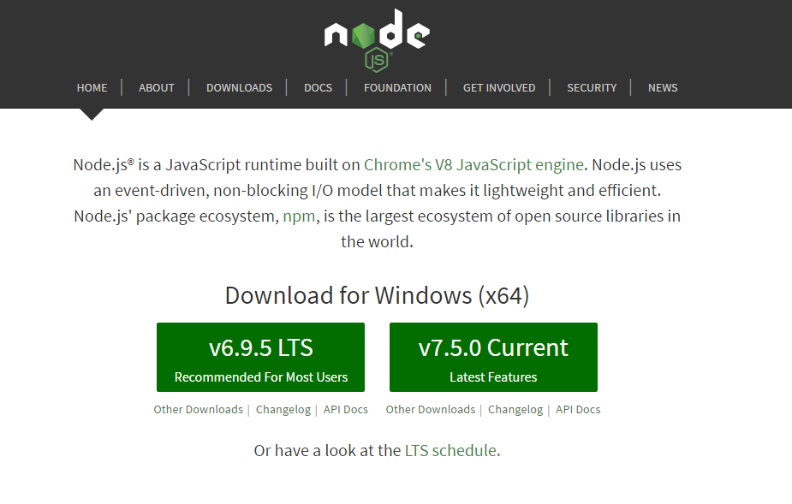

Slide 6
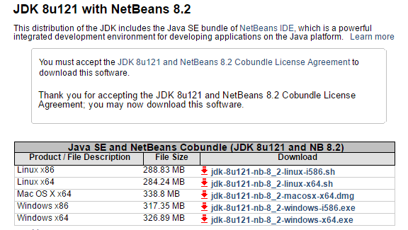

Slide 7
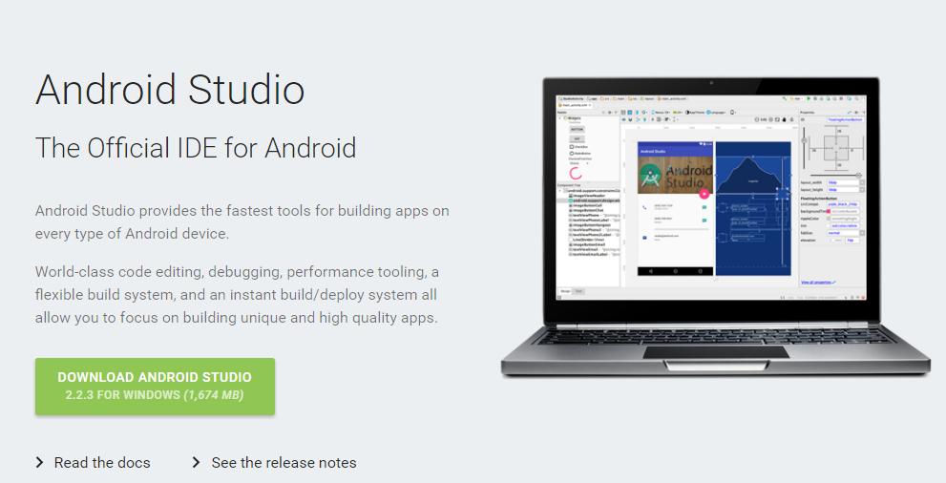

Slide 8
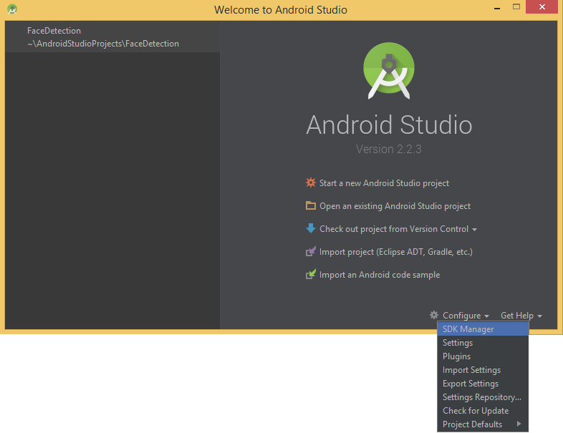

Slide 9
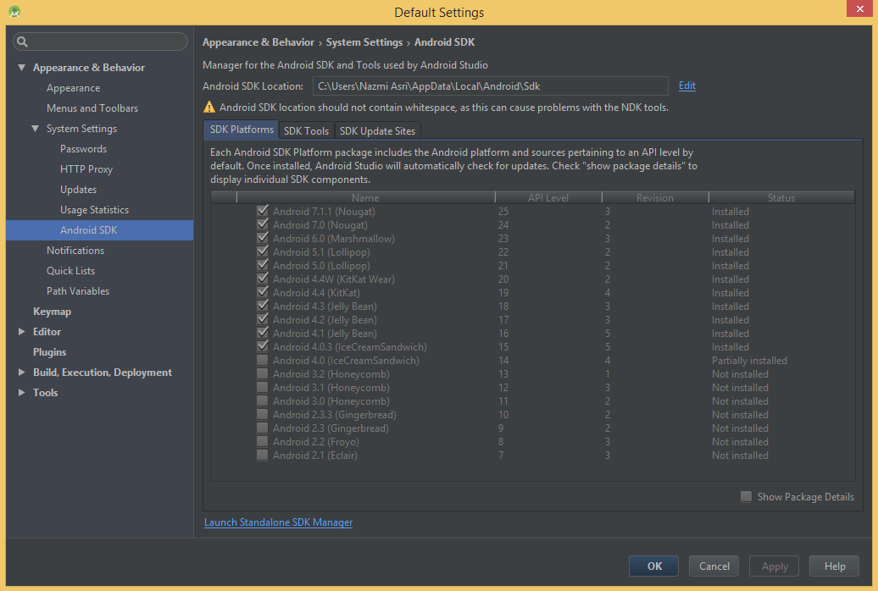

Slide 10
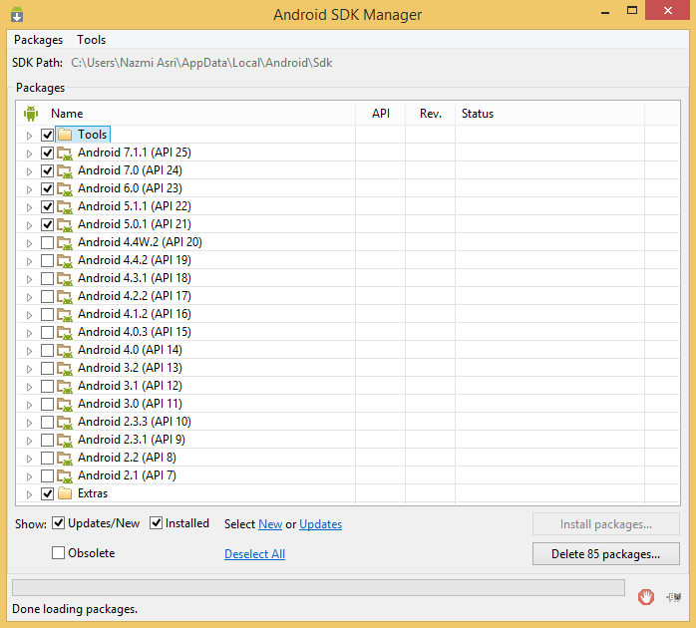

Slide 11
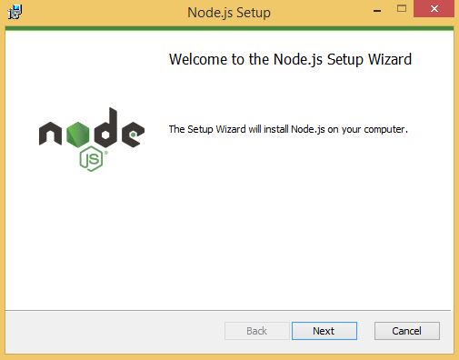
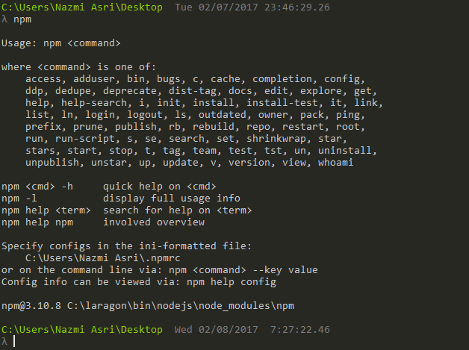
Step 1
Install Node.js : https://nodejs.org/en/ & open your terminal, try npm command

Slide 12
Step 2
In your terminal, run ‘npm install –g cordova ionic’ . This is to install cordova and ionic on you computer, that can be used globally (-g)

Slide 13
Step 3
In your terminal, type ‘ionic’ and press enter. This is to check whether ionic is working or not.

Slide 14
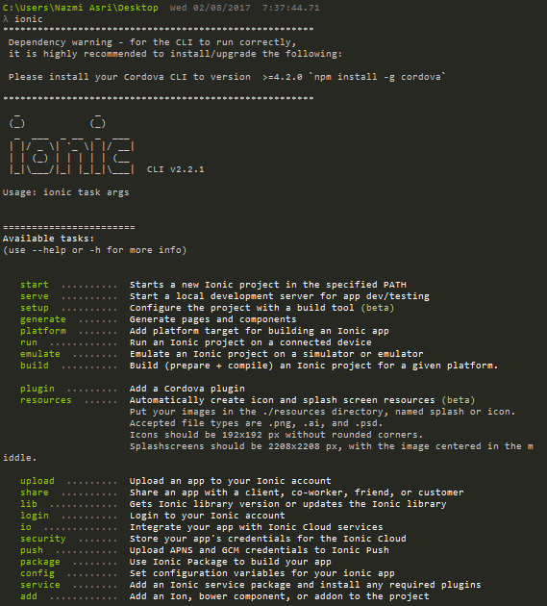

Slide 15
Step 4
Let’s create a blank ionic project , run ‘ionic start myApp blank’

Slide 16
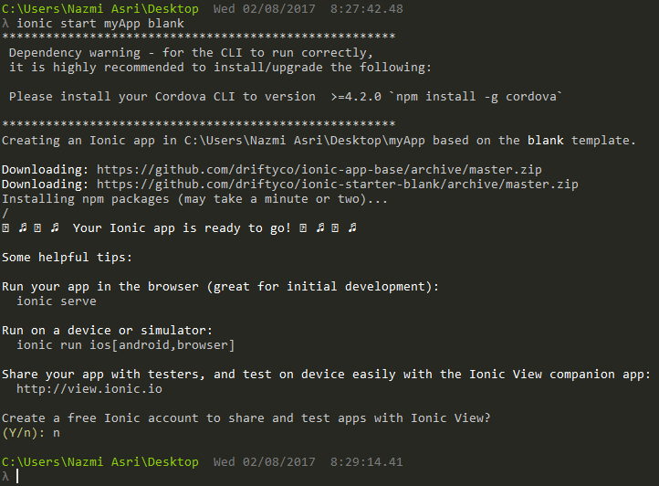

Slide 17
Step 5
Now, enter into the project folder – cd myApp
Run ‘ionic serve --lab’ to execute ionic app on web browser such as Google Chrome. (--lab) means that we want to view it on iOS and Android view in browser.
If ionic asked which address to use, select the one with ‘localhost’
Next, go to your web browser (Google Chrome, Edge, Firefox) and open http://localhost:8100/ionic-lab

Slide 18
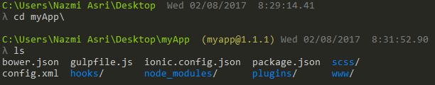

Slide 19
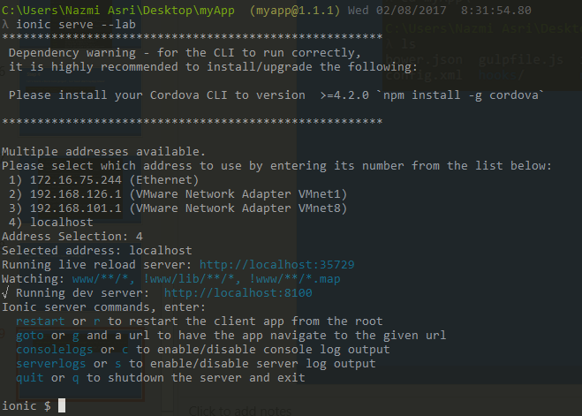

Slide 20
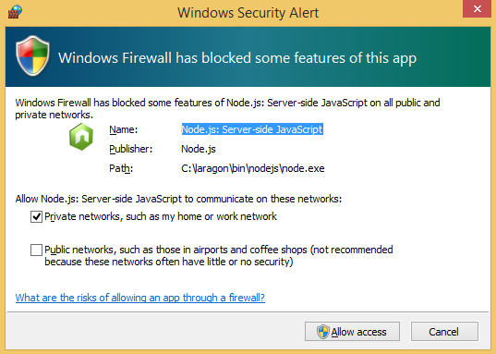

Slide 21
